Slide 1
Climate Change and Agricultural Crops : Nepal
Chet Raj Upreti, PhD Principal Scientist
Nepal Agricultural Research Council (NARC)

Slide 2
Presentation Layout
Land Use Pattern of Nepal
Climate change and the consequences in Agriculture
Cropping and Animal Husbandry Nepal
Environment relating with Agriculture
Metrological Station set up
Challenges and Opportunities
Way Forwards.

Slide 3
1.Background
Geographical Setting:
Latitude: 26º 22' N to 30⁰37' N
Longitude: 80⁰15' E to 88º 15' E

Slide 4
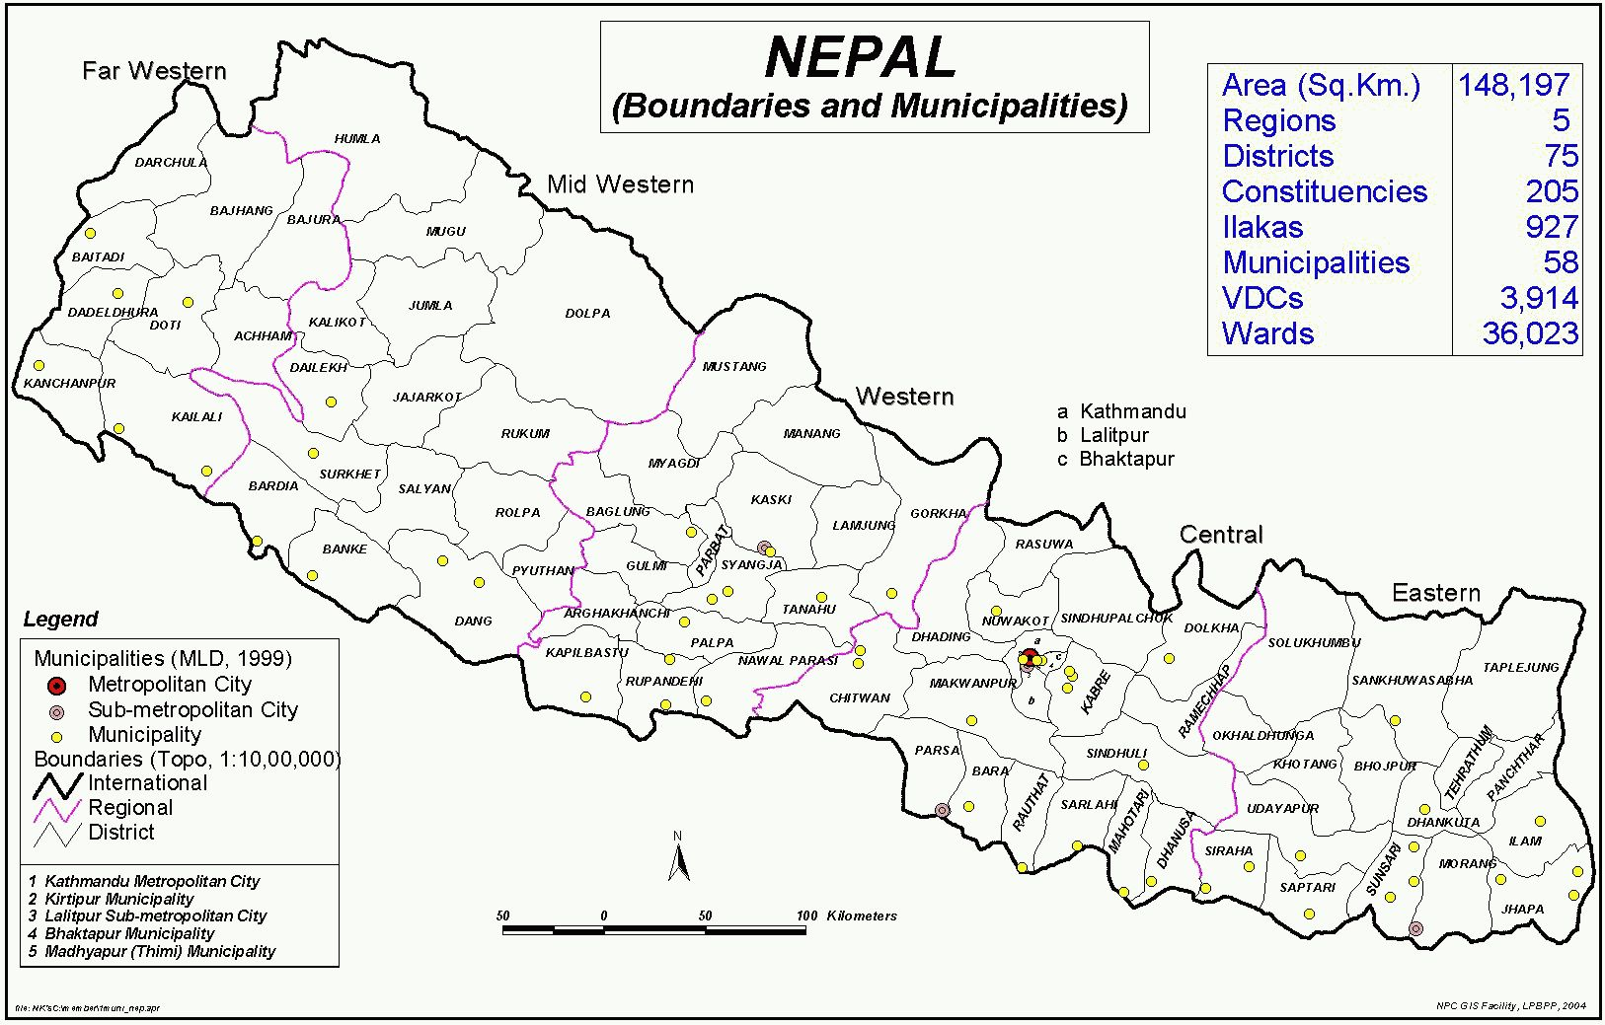

Slide 5
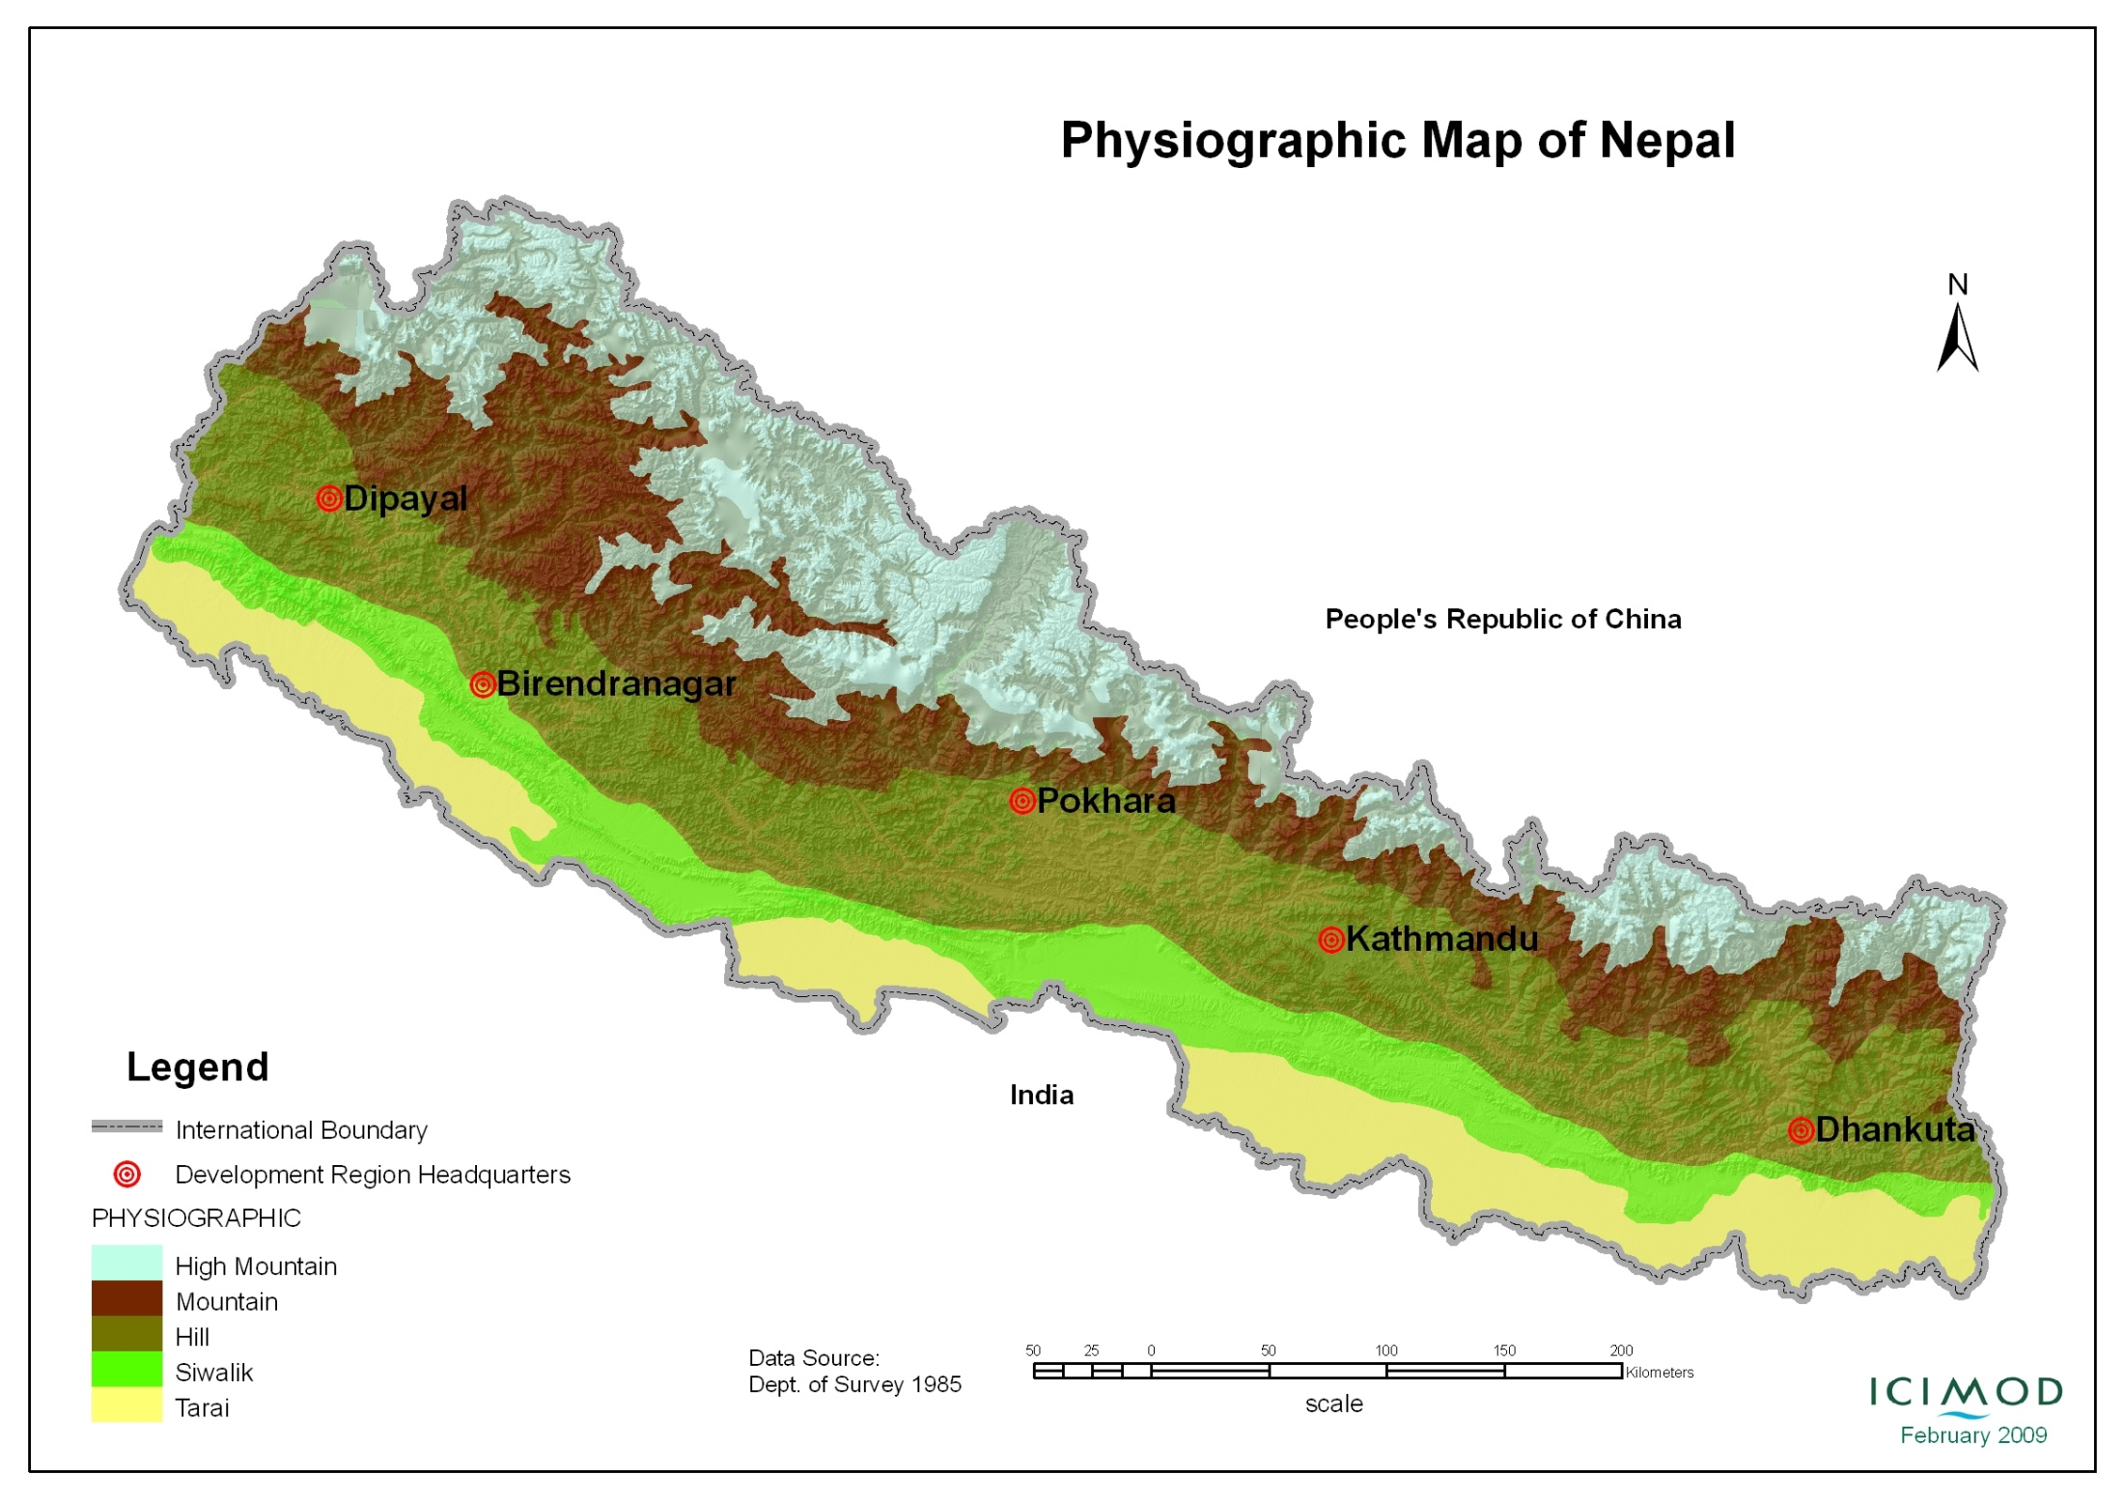
Physiographic Map of Nepal

Slide 6
Physiographic Region
Land Units | Elevation (m asl) | Feature
1.Terai | 60-300 | 52 % of total cultivated and
2. Hills | 700-1500 | 42% of total cultivated land
3. Mountain | 15000-3000 | 6% of total cultivated land

Slide 7
2. Land use pattern
Total Land Area 147484 square kilometer or 147448,396 ha
 | Total Area (Sq. Kilometer) |  | Cultivated area (h)
Agro eco zone | Area | Percent Share | Area (h) | Percent Share
1 Tarai | 34099 | 23.12 | 1359000 | 51.50
2. Mid hills | 61523 | 41.72 | 1055000 | 39.90
3.Mountain | 51862 | 35.16 | 227000 | 8.6
Total | 147484 | 1000 | 26,41,000 | 100
Notes:
2.6 million cultivated land

Slide 8
Land use pattern … Agro -eco zones and Ag. Farming
Regions | Elevation (m asl) | Expansion | Percent Share | Crop cultivation/ Livestock (Mixed Farming System of Management)
1.Tarai Region | 60-300 | 15 to 20 km in breadth The land slop or gradient 2-10m per km. | 23 | Major Crop: Corn, Rice, wheat, Potato, Livestock - Cattle, Buffalo, goats, pigs and Poultry,
2.Mid hills Region | 700-1500 | Variable | 42 (42% of total cultivated land) | Crop: Maize, rice, wheat, Potato Livestock: Cattle, Buffalo, goats, pigs and Poultry
3.Mountain Region | 1500 -3000 | Variable | 35 | Crops:Potato, barley, wheat, Livestock: Yak, Chauri, Chinese wheat Chyangra goat, Byanglung Sheep, Danfe bird

Slide 9
Land use pattern…
Use | Area (hact) | Share (Percent)
1.Khet Land (Low land) | 7,33,942 | 27.79
2.Pakho land (Upland) |  | 53.59
Total Net cultivated area | 26,41,000 (2.64 million) | 100
Notes:
0.733 million hact

Slide 10
3. Climate Change and the Consequences in Agriculture
Agriculture, health and environment affects by the changed climatic condition.
Changed rainfall and temperature impacts on the agricultural crop production including the livestock and fish farming.
A traditional cropping pattern ( crop can be affect by the changed climatic effect) that affect on the food security
Uncertainty of weather, can affect on the cropping pattern.
Chances of disease occurrences are prominent in the change context.
Climatic stress on the plants and animal causes drastic reduction in the production.

Slide 11
Impact of climate Modeling on Agriculture
Science of climate modeling can be tools as an input to the crop and livestock husbandry.
Down scaling is the pre-basic data base for agricultural safety.

Slide 12
4. Cropping System
Cropping system is dependant on the agro ecological zone f the country
Crops commodities are diversified
Established multi cropping system, and mixed livestock husbandry can be destroyed by the climate change

Slide 13
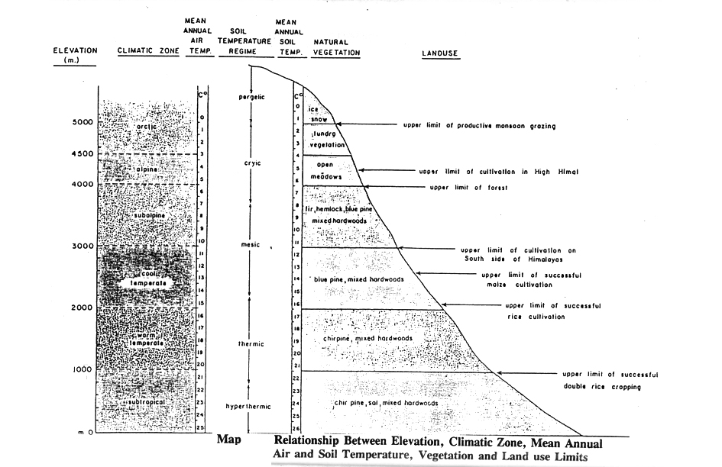

Slide 14
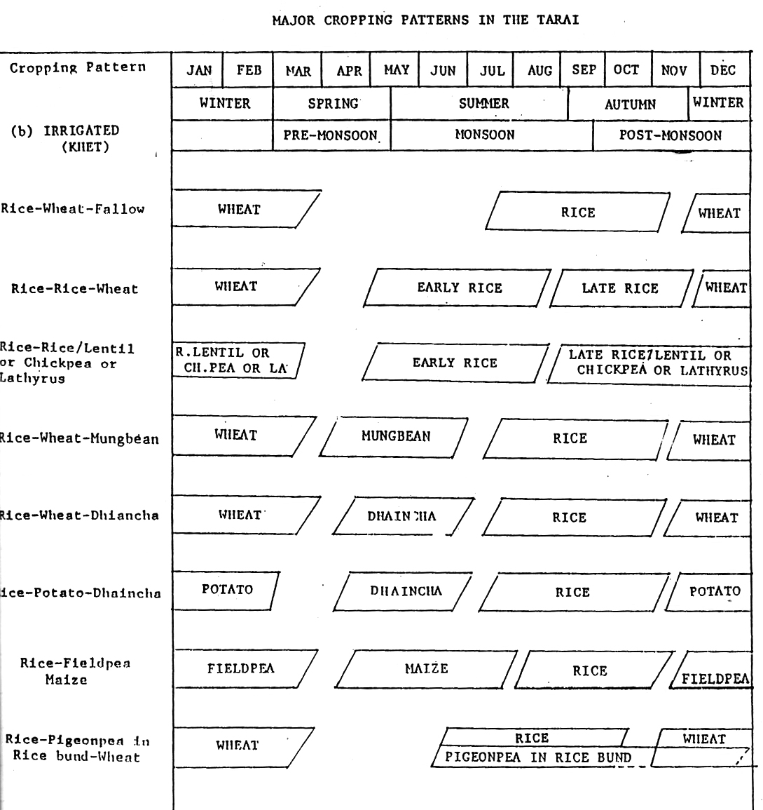
Land Use Pattern

Slide 16
Cropping/and Husbandry pattern
The existing cropping system is very suitable that fits in traditional agrarian system like we can see from above chart.
Any intervention to promote the food and foods should fittin in the ecosystem, and one of the input is the Climate Modeling that has practical implication to the users.
The changes in the climatic affects on the sequential cropping/ farming patterns: destroys the potentials.

Slide 17
Animal Farming and Movement with the climate change
Due to the warmer winter the Yak movement has shifted upper elevation and cross like Chauri (hybrid)
The zone of disease appearance of both plant and animal has widen enough due to the climatic varialtion.
Lack of pre information huge number of animal losses in the Himalaya..

Slide 18
5. Environment
Agriculture in Nepal is complex, to the diversity of crops and livestock raising environment.
Land orientations creates micro-climatic regions;
Mountain, Deep valley, varying slope, and aspects within the short distance from South to North.

Slide 19
Environment …
Climatic zones
Climatic zones | Elevation (m asl)
1. Su-tropical | Less than 1000
2. Warm Temperature | 1000-2000
3. Cool Temperature | 2000-3000
4. Sub. Alpine Temperature | 3000-4000
5. Alpine temperature | 4000-4500
6. Arctic zone | More than 45000

Slide 20
Environment…
Seasons | Months
1. Winter | December to February
2.Spring | March to May
3.Summar | June to September
4.Autumn | October to November
Seasons of Nepal

Slide 21
6.Metrological Setup in the country for Agricultural Purpose
Under the Ministry of Science, Technology and Environment, Department of Hydrology and Metrology is the official govt. organ to work with Climate and Environment
There are total 283 Metrological station in the country out of which 18 works as Agro -metrological Station.
All Agro-Metrological Station are based in Agricultural Research Station under NARC and that is a setup that helps to collect the data related in crops, Horticulture and animal Research
Recently NARC has established a separate Division to work on the Climate and environment called “ Agricultural Environment Division”
NARC is also working with other agencies such as USAID, DFID in the line of crop and Livestock Research related to climate change and have separate metrological Station to collect the daily weather information such as Feed the Future Innovation Lab Collaborative Research (USAID) where MAIRS is also helping in Capacity Building (Providing opportunity to participate in workshop).

Slide 22
Metrological Setup in the country for Agricultural Purpose ………
DHM Citizen Charter
Weekly, Monthly and quarterly weather report
24 hours weather forecasting for general public
These informations are useful to relate with the crop and animal farming

Slide 23
Environment…Rainfall (Source: DOHM)
Region | Pre-Monsoon (%) | Monsoon (%) | Post Monsoon (%) | Winter (%)
1.Tarai | 4-11 | 80-89 | 2-7 | 2-5
2. Hilly Region | 2-20 | 79-92 | 1-11 | 2-9
3.High Hilly Region | 8-24 | 72-80 | 1-9 | 4-17
Seasonal Distribution of Rainfall
Pp 5 of Seasonnal Distribution
Manadhar

Slide 24
Methodology of Climatic Data Analysis
For analysis, data records of two districts were collected and analyzed
The finding are based on the linear trend analysis and coefficient of variation of under taken study areas.
The time series records have been presented in this presentation. Example:

Slide 25
Agro data recorded in the stations (Avr.25 years)(200 m asl)
Month | Mean Temp |  |  | Total Rainfall | Evaporation | Mean Soil Temp
 | Max | Min | Mean |  |  | 5 cm | 10 CM | 30 CM | 50 CM
Jan | 23.4 | 8.9 | 16.15 | 15.7 | 3.3 | 14.2 | 14.6 | 17.8 | 18.9
Feb | 25.5 | 9.9 | 17.70 | 14.0 | 2.8 | 14.0 | 15.7 | 18.7 | 19.5
March | 30.3 | 14.0 | 22.15 | 15.6 | 4.5 | 18.0 | 19.8 | 21.9 | 22.0
April | 31.1 | 19.5 | 26.30 | 64.2 | 6.1 | 24.7 | 24.7 | 25.9 | 25.9
May | 32.8 | 22.6 | 27.7 | 163.7 | 6.0 | 27.1 | 26.9 | 25.0 | 28.5
June | 32.8 | 24.7 | 28.75 | 314.4 | 5.4 | 28.8 | 28.9 | 29.6 | 29.5
July | 32.0 | 24.6 | 28.30 | 482.4 | 4.5 | 28.6 | 28.7 | 29.7 | 30.0
August | 32.4 | 24.9 | 28.65 | 366.2 | 4.5 | 29.2 | 29.1 | 30.3 | 30.4
Sept | 31.9 | 23.7 | 27.80 | 316.5 | 3.7 | 27.8 | 27.8 | 29.4 | 29.9
Oct | 31.1 | 20.9 | 30.15 | 94.9 | 3.4 | 24.9 | 25.0 | 27.1 | 27.8
Nov | 28.9 | 14.8 | 21.85 | 12.9 | 2.7 | 20.3 | 20.6 | 23.3 | 24.5
Dec. | 25.4 | 10.1 | 17.75 | 11.1 | 2.0 | 15.9 | 16.5 | 19.5 | 21.0

Slide 26
Climatic variability of Nepal

Slide 27
Figure 1 Average annual rainfall, maximum and minimum temperature, Pakhribas (1985-2010)

Slide 28
Figure 2: Average annual rainfall, maximum and minimum temperature, Tarahara (1984-2010)

Slide 29
Figure 3: Average rainy seasonal rainfall, maximum and minimum temperature, Pakhribas (1985-2010)

Slide 30
Figure 18: Average rainy seasonal rainfall, maximum and minimum temperature, Tarahara (1984-2010)

Slide 31
Figure. 5 Monthly agro-meteorological data of Khumaltar 2068/69 (2011/12)

Slide 32
Climatic variations
Agriculture, health and environment affects by the changed climatic condition.
Agriculture in the country is highly dependable on rainfall and is very sensitive to even a short term weather change.

Slide 33
7. Initiation to relate with Climate Modeling to agriculture
Work has been started in India relating the soil moisture temperature incorporating with the model: a very good initiation.
This type of work needs to be promoted.
Diagnostic tools as a model needs to be further elaborated and extended
A relationship of soil moisture and temperature
Understanding the climate related information and the trends existed could help to take right initiation and measures to mitigate their adverse effect of climate change in the country.

Slide 34
8.Challenges and Opportunities
To feed the future, hybrid genotypes technology are emerging and are able to boost up the production. But these are very sensitive to and responsive with change climate: Demanding the early information to adjust the cropping pattern to save the crop. Early information or prediction of the weather would be in the line to take early decision to adjust accordingly.
Opportunities to use the modeling output in different discipline such as in agriculture, health and environment.

Slide 35
9. Way Forward
Modeling data are the input to the agriculture, it is in the line to progress. The data base should be scaled up to the farming community as they are the end user. We need to built a net work making the multi disciplinary expert working in animal agriculture . Focusing to the end user.
Now this is the time for more collaborations and capacity building (including the young agricultural Scientist) in the line to develop technique and use.
Action oriented research needs to be incorporated that can alert to the farmers in time to save the plant and animal crops
Request to organizer to make team of agriculturist : as they are the end users ( Crop, Horticulture and Animal Husbandry ) who can help to make policy stream line the technology update to use the developed model in rural agrarian community.
Expansion of

Slide 36
Way forward…
Automatic Weather Station (AWS) in different location needs to be established.
Weather forecasting for agriculture use needs to be promoted..
Agricultural scientist, academician and extension expert should get an opportunity to use the technology generated by the Modeler Groups (working hard to work for our people) as they are the real customer of the outputs.

Slide 37
Way forward…
CRSPs: NARC is also working with other agencies such as USAID, DFID in the line of crop and Livestock Research related to climate change and have separate metrological Stations.
Some Example: Feed the Future Innovation Lab Collaborative Research (USAID) where MAIRS is also helping in Capacity Building (Providing opportunity to participate in workshop
Component Two: Needs to be included in the network;
For uptake by the user and scaling – up (i)Pre-Basic (ii) Basic and (iii) Advance Phase.
Now time has come to formulate Panelist for User Group to make develop technology user friendly for Component II (User).

Slide 38
Acknowledgement s
WCRP, CORDEX, MAIRS, APN, IAP, CCCR,
ICIMOD
Dr. Allikun
Dr. Arun Bhakta Shrestha,
Dr. Mandira Shrestha Singh, and the ICIMOD
Officials

Slide 39
Thank You All

